Slide 1
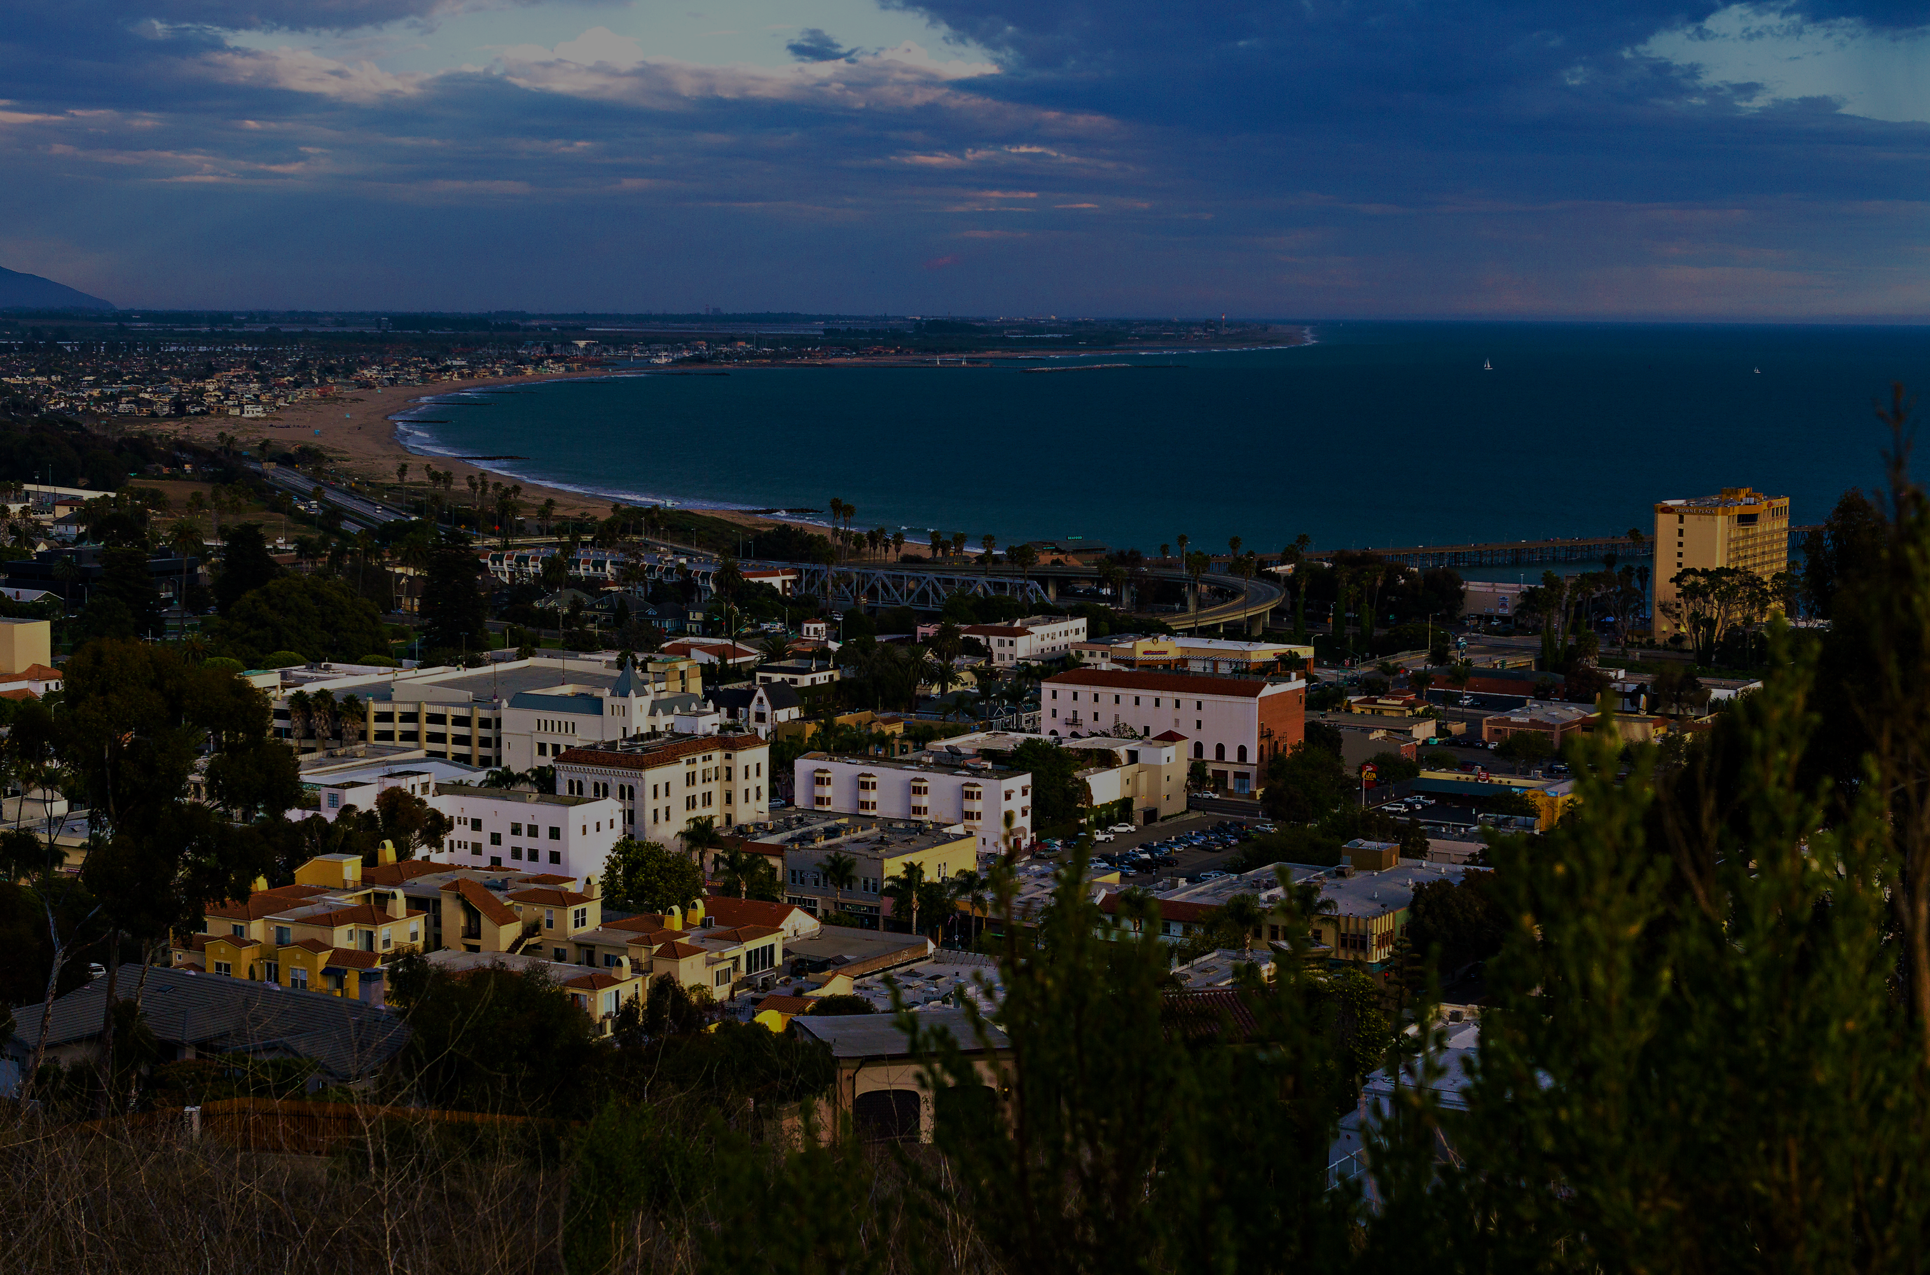

County of Ventura
Drought Resilience Plan
Drought Task Force Draft Drought Resilience Plan Meeting 2
March 10, 2026
Photo Credit: Diego Camargo

Slide 2
Drought Resilience Plan Welcome and Introductions

Slide 3
Zoom Q&A
Participants have been muted, and all questions should be submitted through the Zoom Q&A feature.
Questions will be answered and published throughout the presentation. If time allows, we will address questions live.

Slide 4
What is the County of Ventura Drought Resilience Plan?
Purpose: The County of Ventura Drought Resilience Plan (County Drought Resilience Plan) evaluates potential drought and water shortage risks and provides emergency and interim solutions for water shortages, fulfilling Senate Bill (SB) 552: Drought Planning for Small Water Suppliers, State Small Water Systems, and Domestic Well Communities (Hertzberg) requirements.
Scope: The Drought Resilience Plan applies exclusively to domestic wells and state small water systems within the County.
State small water system: A system for the provision of piped water to the public for human consumption that serves at least 5, but not more than 14, service connections and does not regularly serve drinking water to more than an average of 25 individuals daily for more than 60 days out of the year, as defined in Section 116275 (n) of the Health and Safety Code. Water Code §10609.51(k)
Domestic well: A groundwater well used to supply water for the domestic needs of an individual residence or a water system that is not a public water system and that has no more than 4 service connections, as defined in Section 116681 of the Health and Safety Code. Water Code §10609.51(m)

Slide 5
  County Drought and Water Shortage Task Force
Drought Task Force Charter
  Describes the roles, responsibilities, membership, and decision-making authorities of County, PCT, Task Force
  Includes a Communication and Engagement Framework
Water Shortage Task Force (Task Force) – Consistent with California Water Code (CWC) Section 10609.70(a)(1):
  A county shall establish a standing county drought and water shortage task force to facilitate drought and water shortage preparedness for state small water systems and domestic wells within the county’s jurisdiction, and shall invite representatives from the state and other local governments, including groundwater sustainability agencies, and community-based organizations, local water suppliers, and local residents, to participate in the task force.

Slide 6
Introductions
County Project Coordination Team (PCT)
Anastasia Seims, P.E. – Public Works, County Lead
Shawna Schlageter – CEO Office, County Lead
Kim Dellacort, Sheriff’s Office of Emergency Services
John Gauthier, Watershed Protection Group
Timothy Krone, Environmental Health
Shelley Sussman, Planning Division
Stantec Team
Rina Buck-Macleod, PE, County CSP Lead
Emily Huang, County CSP Deputy
California Department of Water Resources (DWR)
Julie Ekstrom, PhD, Program Manager
Sarah Ko, Deputy Program Manager
County Drought Task Force
In compliance with SB552, County has invited representatives from the state and other local governments, including groundwater sustainability agencies, and community-based organizations, local water suppliers, and local residents, to participate in the Task Force.
Notes:
Project Coordination Team (PCT) – Subgroup of the Task Force (not required by CWC)
Typically comprised of County staff
Day-to-day coordination with Stantec
PCT oversees the Task Force, County Drought Resilience Plan development, and drought planning and is tasked with County Drought Resilience Plan implementation.

Slide 7
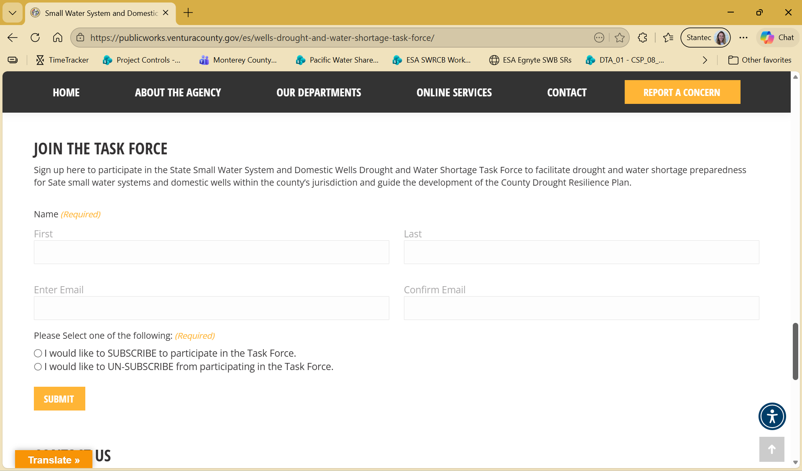
How to Register for the Task Force
Small Water System and Domestic Wells Drought and Water Shortage Task Force Website: https://publicworks.venturacounty.gov/es/wells-drought-and-water-shortage-task-force/

Slide 8
Recap of Drought Resilience Plan Process and Progress to Date

Slide 9
Drought Resilience Plan Development Process
Establish Drought Task Force
A focused County team guides Task Force formation
Conduct Risk Assessment
Use physical and social vulnerabilities to identify where water supply shortages could occur
Align Actions and Strategies
Detail how the County can respond to droughts or water shortages
Complete Drought Resilience Plan
Memorialize process and outcomes for future use by the county
Chapter 2: County Drought and Water Shortage Advisory Group
Chapter 3: Drought and Water Shortage Risk Assessment
Chapter 4: Short-Term Response Actions
Chapter 5: Long-Term Mitigation Strategy and Actions
Chapter 6: Implementation Considerations
Task Force continues supporting monitoring and implementation with the county.

Slide 10
Task Force Outreach and Engagement
December 2025
January 2026
February 2026
March 2026
Drought Resilience Plan Development
Develop Draft
Task Force Review Draft
Develop Final
Task Force Website:
Established
Emails:
Sent Task Force invitations
Task Force Outreach
Standing Task Force Established, As-Needed Engagement
Phone Calls: Engaged state small water systems through direct
outreach
Post Cards:
Mailed to domestic well users
Task Force Meeting 1: Kick Off Risk Assessment Review, and Introduce Short-Term Actions and Long-Term Mitigation Actions and Strategies
Introduce County Drought Resilience Plan and role of Drought Task Force
Present Task Force Charter (Chapter 2), present Risk Assessment and solicit feedback (Chapter 3), solicit input on Short-Term Actions and Long-Term Mitigation Actions and Strategies development (Chapters 4 and 5)
Task Force Meetings
Task Force Meeting 2: Draft Drought Resilience Plan
Solicit feedback on Draft Drought Resilience Plan
Discuss Task Force next steps
Notes:
Confirm Schedule and Proposed Plan forward – November 2025
PCT Meeting – Process Overview and Task Force Charter review (Drought Resilience Plan Chapter 2) – December 2025
Task Force Kick Off Meeting – Outline Drought Resilience Plan process and schedule – January 2026
PCT Meetings to Discuss/Provide Direction on the Draft Drought Resilience Plan (Drought Resilience Plan) Content – February and March 2026
Risk Assessment Overview (Drought Resilience Plan Chapter 1 and Chapter 3 content)
Short-Term Response Actions (Drought Resilience Plan Chapter 4 content)
Long-Term Mitigation Strategies and Actions (Drought Resilience Plan Chapter 5 content)
Implementation of the Drought Resilience Plan (Drought Resilience Plan Chapter 6 content)
Draft Drought Resilience Plan County Review – March 2026
Draft Drought Resilience Plan Task Force Review – April 2026
Final Drought Resilience Plan Delivery – May 2026

Slide 11
Drought Resilience Plan Overview

Slide 12
Drought Resilience Plan Overview
Plan elements must include:
Potential drought and water shortage risks
Proposed interim and long-term solutions for state smalls and domestic wells in the county
Minimum Considerations for implementation include:
Consolidations for existing water systems and domestic wells
Domestic well drinking water mitigation programs
Provision of emergency and interim drinking water solutions
An analysis of the steps necessary to implement the plan
An analysis of funding sources available to implement the plan
Definitions
State small water system: A system for the provision of piped water to the public for human consumption that serves at least 5, but not more than 14, service connections and does not regularly serve drinking water to more than an average of 25 individuals daily for more than 60 days out of the year, as defined in Section 116275 (n) of the Health and Safety Code. Water Code §10609.51(k)
Domestic well: A groundwater well used to supply water for the domestic needs of an individual residence or a water system that is not a public water system and that has no more than 4 service connections, as defined in Section 116681 of the Health and Safety Code. Water Code §10609.51(m)
Drought: A period of abnormally dry weather that results in water shortages. SB 552
Water Shortage: a condition in which the demand for water exceeds the available supply. SB 552
SB 552 definitions - intended to help small water suppliers and rural communities prepare for and respond to droughts and water shortages, regardless of the source of their water supply.

Slide 13
Ventura County Drought Resilience Plan Overview
Chapter | Content/Purpose
Chapter 1: Introduction | Introduction to County and water profile
Chapter 2: County Drought and Water Shortage Task Force | Task Force purpose and overview
Chapter 3: Drought and Water Shortage Risk Assessment | Identify areas with state small water systems, local small water systems, and domestic wells that are more vulnerable to drought/water shortage
Chapter 4: Short-Term Response Actions | Identify actions taken during onset and throughout a drought/water shortage event
Chapter 5: Long-Term Mitigation Strategy and Actions | Identify long-term, preventative measures that help mitigate drought and water shortage conditions
Chapter 6: Implementation Considerations | Considerations to implement the short-term response actions and long-term mitigation strategy and actions

Slide 14
Draft Drought Resilience Plan Feedback Discussion

Slide 15
Drought Resilience Plan Document Walkthrough

Slide 16
Closing and Next Steps

Slide 17
Drought Task Force Activities Aligned to Water Shortage Stages(from Appendix A)
Water Shortage Stage | Description | Ventura County Actions
Readiness | No major drought or potential water shortage | Annual Drought Task Force Meeting to discuss County DRP Implementation and review water supply health
 |  | Proactive long-term mitigation strategy communications
 |  | Conduct water supply and quality assessment
 |  | Annual website update (as needed)
Warning | Drought or other hazard occurring could cause a water shortage | As-needed Drought Task Force Meeting
 |  | Share available resources for individual emergency preparedness
 |  | As needed, coordinate with relevant organizations: water purveyors, watershed conservation districts, other County departments, non-governmental organizations
Emergency | Water shortage is occurring or is imminent | Initiate Drought Task Force Meeting
 |  | Expedite permit authorization for construction or replacement wells

Slide 18
Resources
Ventura County SB552 Website: Small Water System and Domestic Wells Drought and Water Shortage Task Force - Ventura County Public Works Agency
DWR Risk Assessment Tool and Methodology: Water Shortage Vulnerability Scoring and Tool
DWR Guidebook: DWR County Drought Resilience Plan Guidebook
Questions or Concerns: SB552DroughtResiliencyPlan@venturacounty.gov

Slide 19
The Presentation Has Concluded
Meeting to Remain Open until 12:00 pm
Participants have been muted, and all questions should be submitted through the Zoom Q&A feature.
As time allows, questions will be answered and published until the meeting concludes.
This meeting is recorded and will be posted on the Ventura County SB552 Webpage: https://publicworks.venturacounty.gov/es/wells-drought-and-water-shortage-task-force/

